Slide 1



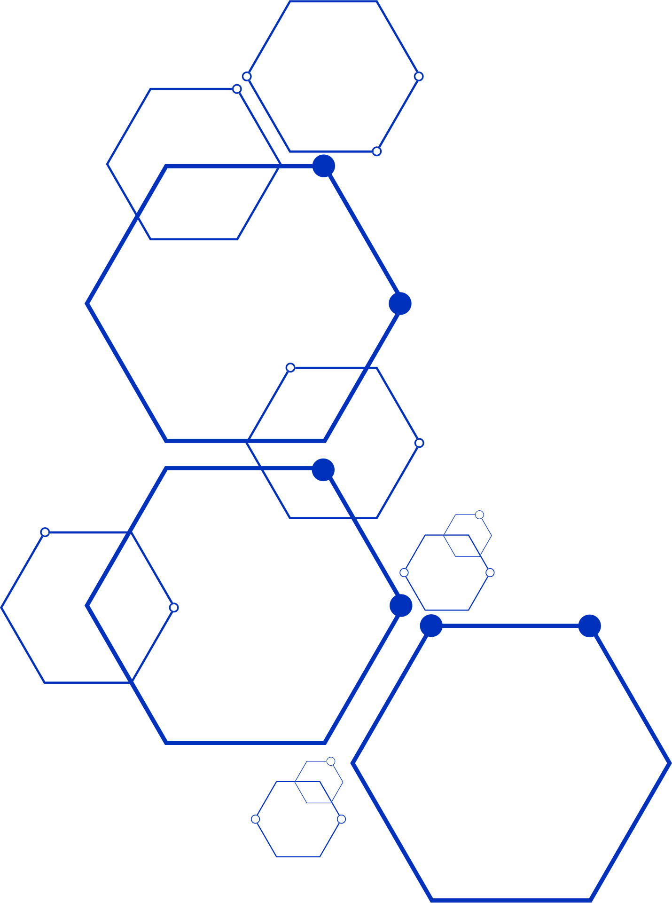

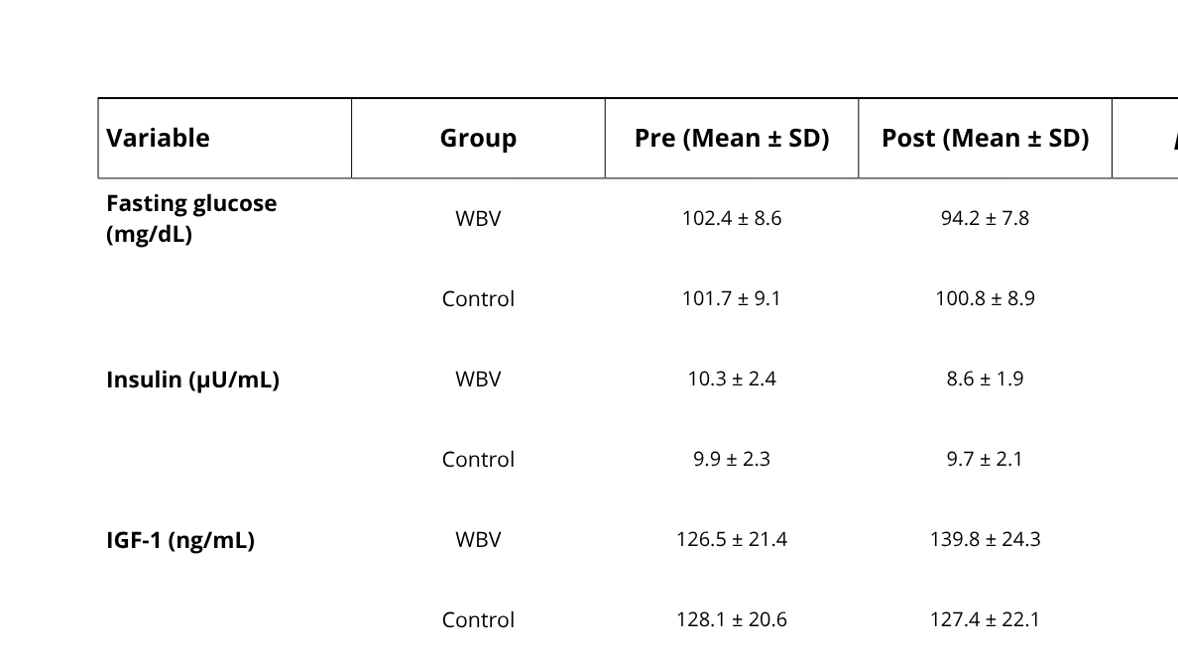






3 International MEVITIH Congress 2025
rd
Innovation, Research and Entrepreneurship in Health
Rio de Janeiro, Brasil
POSTER ID
4-7 november
MEV - XX
th
Effects of Whole-Body Vibration Exercise on Glycemic Control and IGF-1 Levels in Elderly Individuals
Smith J¹, Cardoso A², Silva A²
1¹Department of Physiology, University of Oxford, UK.
²Laboratory of Human Performance and Vibration, Federal University of Rio de Janeiro, Brazil.
IINTRODUCTION
RESULTS
Whole-body vibration (WBV) exercise has emerged as a non-invasive strategy to improve metabolic and endocrine responses in older adults. However, its effects on glycemic control and insulin-like growth factor 1 (IGF-1) remain unclear.
After 8 weeks, the WBV group showed a significant reduction in fasting glucose (p<0.05) and insulin levels (p<0.05), along with a moderate increase in IGF-1 (p=0.06). No significant changes were observed in the control group.
Table 1. Baseline and post-intervention biochemical parameters of participants
OBJECTIVE
To investigate the effects of an 8-week WBV exercise protocol on fasting glucose, insulin, and IGF-1 serum levels in elderly individuals.
METHODS
Twenty-four participants (≥60 years) were randomly assigned to a WBV group or a control group. The WBV group performed sessions three times per week using a side-alternating platform (30–40 Hz, 2–4 mm, 10 min/session). Blood samples were collected pre- and post-intervention to assess biochemical parameters.
Values are expressed as mean ± standard deviation (SD). WBV: whole-body vibration.
CONCLUSION
WBV exercise may be an effective and safe alternative for improving glucose metabolism and IGF-1 response in elderly individuals. Further studies are warranted to confirm these findings and explore long-term adaptations.n
REFERENCES
Cardinale M, Bosco C. The use of vibration as an exercise intervention. Exerc Sport Sci Rev. 2003;31(1):3–7. doi:10.1097/00003677-200301000-00002
Machado A, García-López D, González-Gallego J, Garatachea N. Whole-body vibration training increases muscle strength and mass in older women: a randomized-controlled trial. Scand J Med Sci Sports. 2010;20(2):200–7. doi:10.1111/j.1600-0838.2009.00919.x
Figure 1. Description about the procedure
Organized by
Financial support
Published in

